Slide 1

STUDENT NAME : Dharshini.R REGISTER NO : 2422k1740 NM ID : autbru5h2422k1740 DEGREE : B.Sc Computer Science COLLEGE : Adharsh Vidhyalaya College Of Arts And Science For Womens UNIVERSITY: Bharathiar University

Slide 2

INTERACTIVE DIGITAL PORTFOLIO USING FOR FRONT END WEB DEVELOPMENT
INTERACTIVE DIGITAL PORTFOLIO USING FRONT END WEB DEVELOPMENT

Slide 3

AGENDA
Problem Statement
Project Overview
End Users
Tools and Technologies
Portfolio design and Layout
Features and Functionality
Results and Screenshots
Conclusion

Slide 4

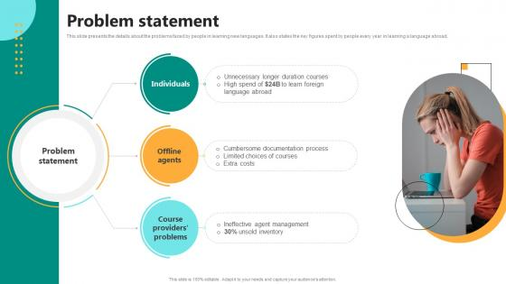
Problem statement
The problem statement for an interactive digital portfolio in front-end web development centers on effectively showcasing a developer's skills, projects, and potential to prospective employers or clients in a dynamic and engaging manner.

Slide 5

PROJECT OVERVIEW
A project overview is a concise, single-page summary of a project's essential information, including its problem statement, goals, scope, timeline, budget, and key deliverables. It serves as a brief introduction and a high-level reference point for team members, stakeholders, and managers, ensuring everyone understands the project's purpose and objectives from the outset and throughout its lifecycle.

Slide 6

END USERS
An end user is the person or entity who directly consumes or uses a product, service, or system, as opposed to the customer who may have purchased it. For example, employees who use software in their daily work are the end users, even if their company was the customer that bought the software. Understanding end users' needs is crucial for product development, as their feedback and satisfaction are vital for a product's success and for improving its design and usability.

Slide 7
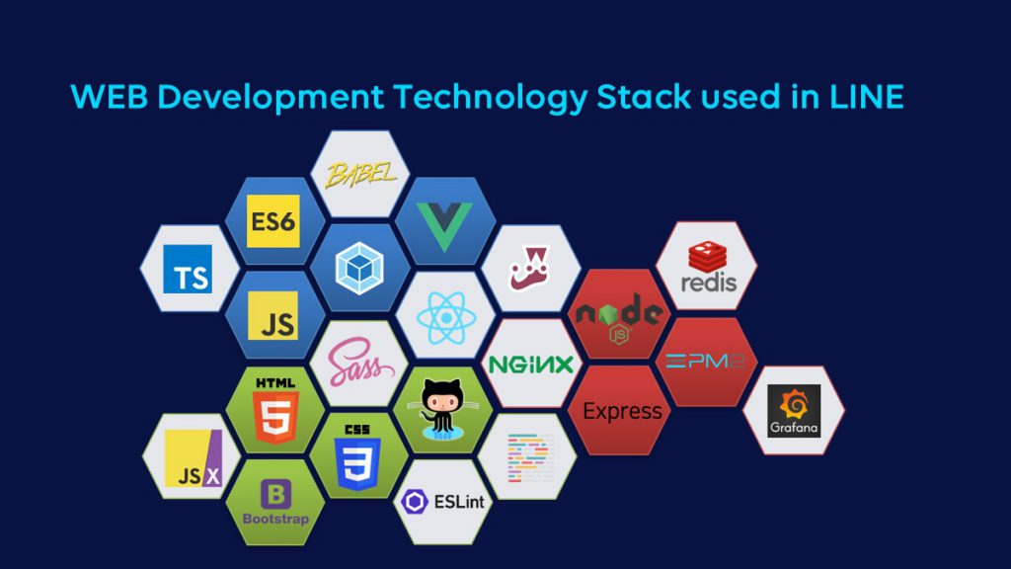
TOOLS AND TECHNOLOGY
Tools
Definition:
Objects, whether physical (like a hammer or saw) or digital (like a software application), designed to assist people in performing specific tasks more easily, efficiently, or precisely.
Examples:
A hammer, screwdriver, knife, or a complex machine like a 3D printer.A word processor, a project management platform
Technology
Definition:
The application of organized knowledge to develop methods, processes, and devices to solve problems and meet human needs. It can also refer to the tools and the structured knowledge that make these methods possible.
Examples:
The wheel for transportation, the internet for communication, or printing technology. The scientific understanding and principles behind how to design and build a computer or software

Slide 8

PORTFOLIO DESIGN AND LAYOUT
For an interactive portfolio, include features like sliders, clickable sections, live demos, and case studies that detail the project's process, challenges, and solutions, often using tools like React for dynamic elements.
interactive features include sliders, carousels, clickable buttons, and animated elements to demonstrate your skills and create an engaging user experience.

Slide 9

Features And Functionality
Responsive Design:
Ensure your portfolio is mobile-friendly and adapts seamlessly to different screen sizes, from desktops to phones.
Clear Navigation:
Design an intuitive and consistent navigation structure, making it easy for users to find information quickly.
High-Quality Visuals:
Use high-resolution images and consistent branding to maintain a professional and aesthetically pleasing look.
Fast Loading Speed:
Optimize your portfolio to load quickly, especially for mobile users, to avoid frustration and maintain engagement.

Slide 10
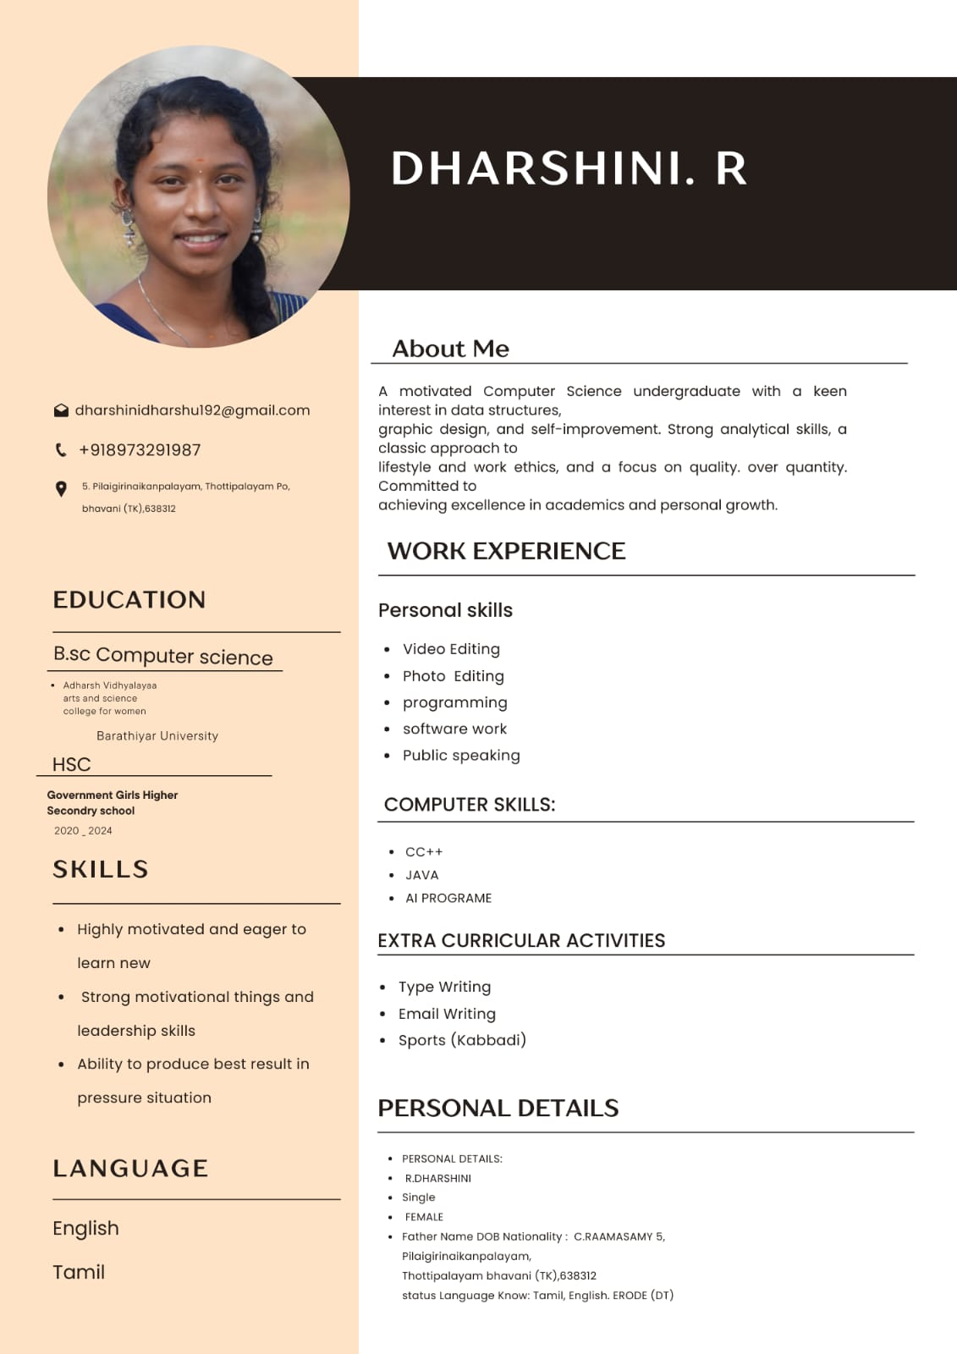
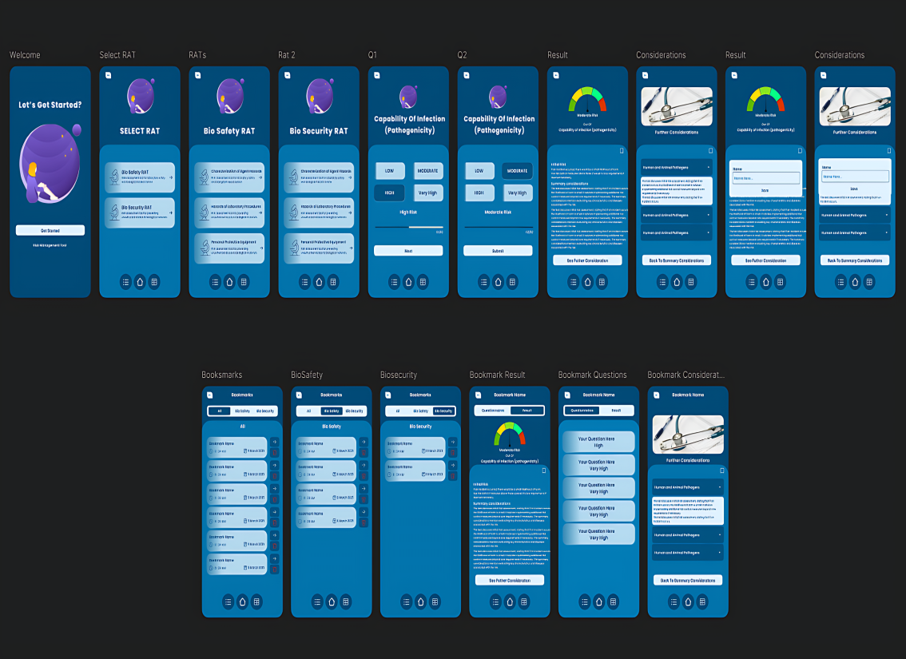
RESULTS AND SCREENSHOTS
An interactive digital portfolio built using front-end web development serves as a dynamic and engaging showcase of a developer's skills and projects. It is a crucial tool for demonstrating practical abilities and creativity to potential employers or clients

Slide 11

CONCLUSION
An interactive digital portfolio is a powerful tool for professionals to demonstrate capabilities. By implementing front-end development techniques. individuals can craft engaging, responsive, and accessible portfolios that appeal to their target audience, ultimately improving career opportunities and professional growth.

